Slide 1
BASIC SIMD PROCESSOR
Name: S.V.S.SUDHEEP RAO. Class:2nd year,B.Tech,ECE-A.
Rollnumber:184159.

Slide 2
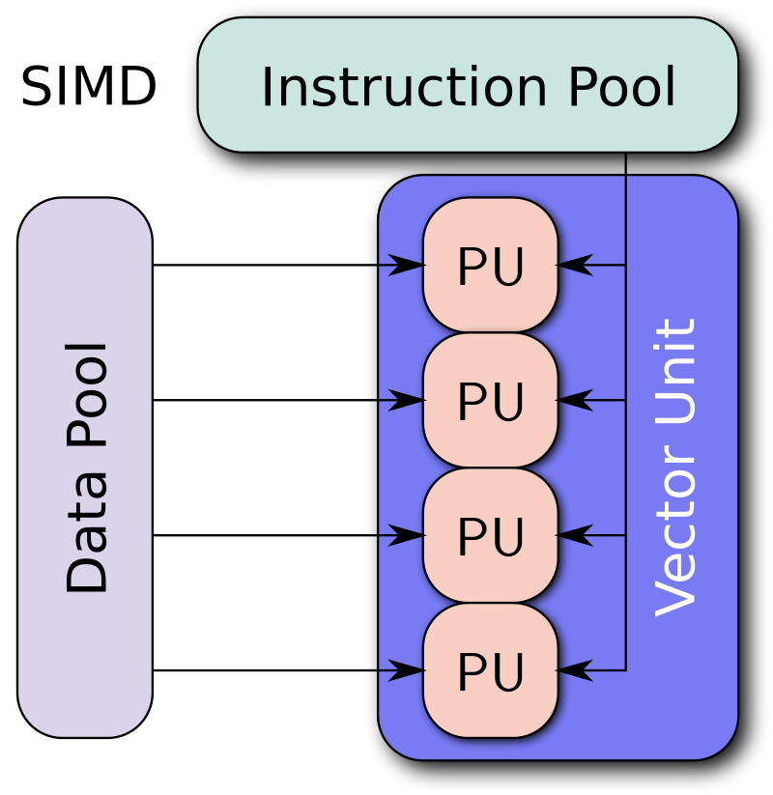
INTRODUCTION (About SIMD architecture)
SIMD stands for single instruction ,multiple data
It describes computers with multiple processing
elements that perform the same operation on
multiple data points simultaneously.
They perform several computations simultaneously
but only of a single instruction

Slide 3
Implementation of 16 bit basic ALU processor
2's compliment calculations are implemented in this Arithmetic logic unit
The operation takes place in two clock pulses
The first clock pulse is used to load the data into the registers
The second clock pulse is used to perform the required operation

Slide 4
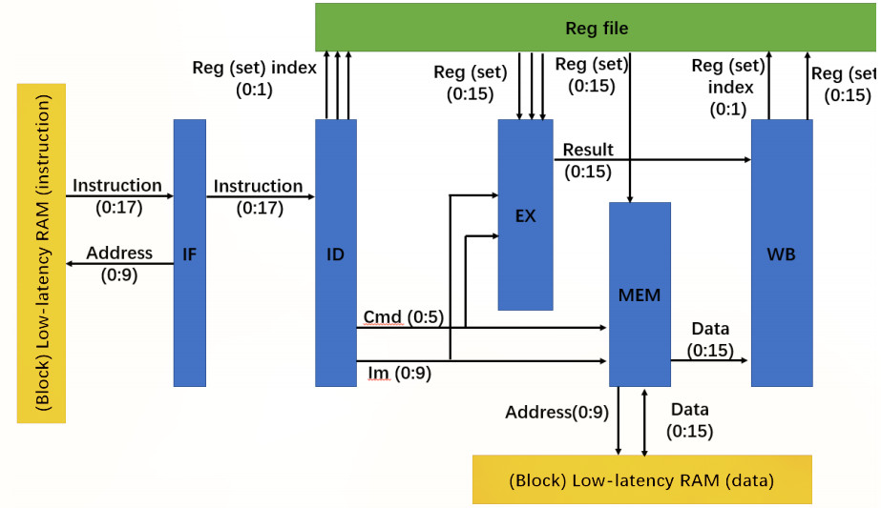
Register file
1
2
3
5
4
Instructions
Data

Slide 5
OPERATION
The ALU will be embedded into a simple processor based on 5-stage, delay of each stage will be 1 cycle, meeting the delay of ALU.
In the stage 1, a 10-bit address will be sent to an instruction block to fetch 18-bit instruction.
In the stage 2, the instruction will be decoded and some of control registers will be set to control the following stage.
In the stage 3, ALU will process data in registers or implement some control commands
In the stage 4, if the instruction is “store” or “load”, data would be read from/ written to data , based on instruction and address.
In the stage 5, data will be written back to register

Slide 6
COMPONENTS IN ALU
SIMD Adder
SIMD Shifter
SIMD Multiplier

Slide 7
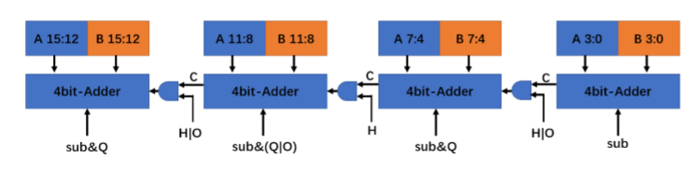
SIMD Adder
The SIMD adder is implemented based on 4 4-bit adders.
The adder can also support subtraction, by flipping the second operand and add one to it when the signal sub is set

Slide 8
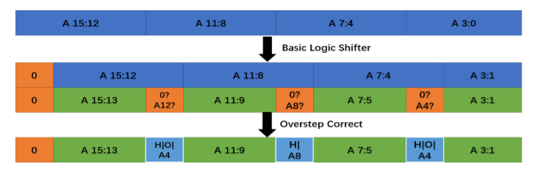
SIMD Shifter
It is based on two 16-bit shifters and necessary overstep-correct logic.
The shifter will determine whether the MSB of 4-bit block should be set to 0 or just inherit the value from the LSB from 4-bit block in front of it, according to the input signal, H and O.

Slide 9
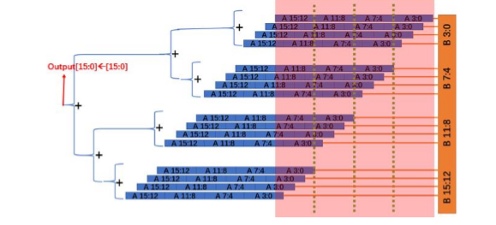
SIMD Multiplier
The SIMD multiplier is implemented with adders and shifters.
To make it support multiplication with different data
width, the input signal, H, O and Q, are
used to control the input operands of
the adders and select corresponding
outputs for the target data width.

Slide 10
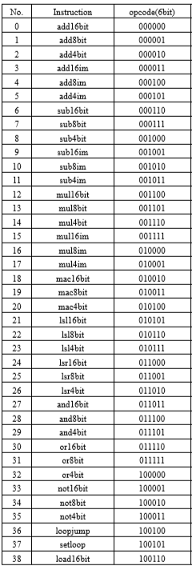
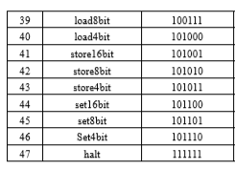
INSTRUCTIONS SUPPORTED
BY THE PROCESSOR

Slide 11
THINGS DONE
coding part of adder ,shifter and multipier is done
Figured out the basic working procedure
THINGS TO BE DONE
The coding part of various instructions is left over.

